Slide 1
NLP Text Processing using Textblob
Brenton Lian

Slide 2
Introduction
TextBlob is a Python library used to perform Natural Language Processing (NLP) tasks including sentiment analysis
Sentiment analysis is the process of analyzing text to determine if the emotional tone of the message is positive, negative, or neutral, or other characteristics.
I analyzed the polarity and subjectivity of the titles of over 700 posts on r/UNC, the Reddit subreddit for UNC Chapel Hill.

Slide 3
Polarity vs Subjectivity
Polarity: Negativity or positivity of the post title. 1 correlates to the most positive, and -1 the most negative.
Subjectivity: How subjective the title is. 1 correlates to being the most subjective, and 0 least subjective.

Slide 4
How Textblob works
Textblob is a library for NLP built upon the Natural Language ToolKit (NLTK).
Textblob has a polarity and subjectivity value for every single word, and is able to hand negations, and accounts for intensifiers (which can increase or decrease the polarity or subjectivity of a word).
Textblob then averages the polarity of every word for a full text.

Slide 5
Top 10 Most Positive
Post # | Title | Polarity
623 | Best professor you've had at Carolina? | 1
370 | best triple-i for spring 2024? | 1
646 | Spacesurf genre playlist the best music to study to imho. | 1
282 | Best Apartment for Off-Campus Students for 2024-2025 | 1
579 | Best places to get Tiramisu? | 1
382 | What is the best Sophmore Dorm? | 1
584 | Best place to look for off campus houses? | 1
519 | Best CHEM102L lab professors? | 1
10 | good studio apartments for fall 2024? | 0.7
631 | What are some good spots on campus to have zoom meetings? | 0.7
Highlight = Possible error

Slide 6
Top 10 Most Negative
Post # | Title | Polarity
381 | brutal honesty needed | -0.875
143 | Extremely sick - PSYCH 101 - Ndidi Adeyanju | -0.714286
152 | hospital sick - PSYCH 101 - Ndidi Adeyanju | -0.714286
64 | What do I do about my bad prof? | -0.7
365 | how bad is a W? | -0.7
624 | Am i crazy or does genome cafe have no working outlets? | -0.6
196 | No heat in dorm and freezing cold | -0.6
92 | Would this be too difficult? | -0.5
114 | Need 1-2 tickets for the game tonight! | -0.5
414 | Unable to find on-campus job | -0.5
Highlight = Possible error

Slide 7
Top 10 Most Subjective
Post # | Title | Polarity | Subjectivity
457 | Potentially Moving to UNC from NJ | Neutral | 1
16 | How is the Chem 102L final? | Neutral | 1
183 | Any Creative Writing Clubs/Groups to Join? | Positive | 1
358 | Is it possible to take classes online at community college while also taking classes at UNC? | Neutral | 1
362 | I can't stand the idea of a 9-5 but I feel naive | Negative | 1
381 | brutal honesty needed | Negative | 1
444 | Admission Question - Unique? | Positive | 1
92 | Would this be too difficult? | Negative | 1
84 | Seeking recommendations for places on Franklin St to find unique gifts | Positive | 1
619 | chem 101 final | Neutral | 1
Highlight = Possible error

Slide 8
Top 10 Least Subjective
Post # | Title | Polarity | Subjectivity
0 | Israel/Palestine Megathread | Neutral | 0
357 | help!! | Neutral | 0
593 | Musc 121 midterm + concert assignment | Neutral | 0
355 | Clubs to Join | Neutral | 0
594 | MAC admissions interview? | Neutral | 0
595 | Spring Semester Registration | Neutral | 0
598 | Apartment recommendations | Neutral | 0
351 | B school spring admit...registration advice needed!! | Neutral | 0
350 | Information Science Admission Release Date | Neutral | 0
349 | How to find a gym buddy? | Neutral | 0
Highlight = Possible error

Slide 9
Possible Errors By Category
Top 10 | # of Possible Errors
Most Positive | 0
Most Negative | 1
Most Subjective | 1
Least Subjective | 9
Errors/Total | 11/40
Top 30 | # of Possible Errors
Most Positive | 5
Most Negative | 10
Most Subjective | 9
Least Subjective | 16
Errors/Total | 40/120

Slide 10
Analysis of Results
Generally mostly accurate: 29/40 accurate for top 10 titles, and 80/120 accurate for top 120 titles
Most errors are in least subjective
Roughly equal amount of errors for top 30 titles, with most positive being lowest
Very poor performance for determining least subjective post titles (but also hard for a human to tell)
High tendency for certain words to falsely trigger low/high polarity and subjectivity (next slide)

Slide 11
False Triggers/Errors
Most positive major error: “Is this place safe?”
Most negative common false triggers: ticket (eg. “Spare student ticket for Syracuse game?”) and game (eg. “Duke Football Game”)
Most subjective false trigger: any free items (eg. “free ticket”, “Free Tuition”)
Least subjective major errors and common false trigger: “Israel/Palestine Megathread”, “help!!”, commonly falsely triggered by advice requests (eg. “Spring Semester Registration”)

Slide 12
Possible Causes of Misinterpretation
Safe is generally considered a positive word, however Textblob does not have a modifier for “safe?” to be considered negative.
Ticket could be associated with traffic tickets, which would be negative.
Free can be used to describe emotion as well, in a highly subjective manner.
Hard to judge if a title is subjective with few words; posts seeking advice like “Spring Semester Registration” could be interpreted as a statement or start of a guide.
Hard to tell why “game” or “football game” has negative polarity

Slide 13
Steps
Create a Reddit developer account in order to access reddit API and information about posts.
Create a dataframe with data
Filter out text elements like emojis that don’t currently work with textblob
Use the Textblob library to create a function that returns the sentiment of every title
Filter accordingly

Slide 14
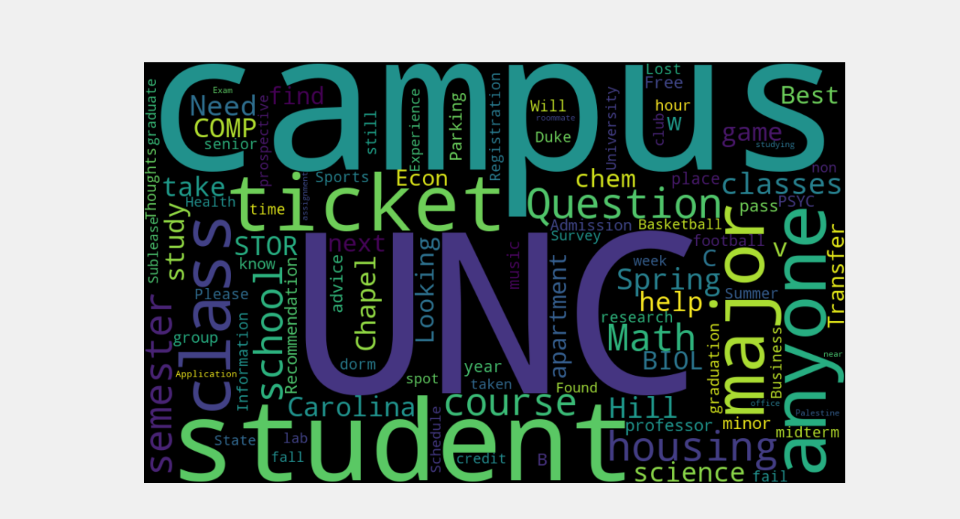
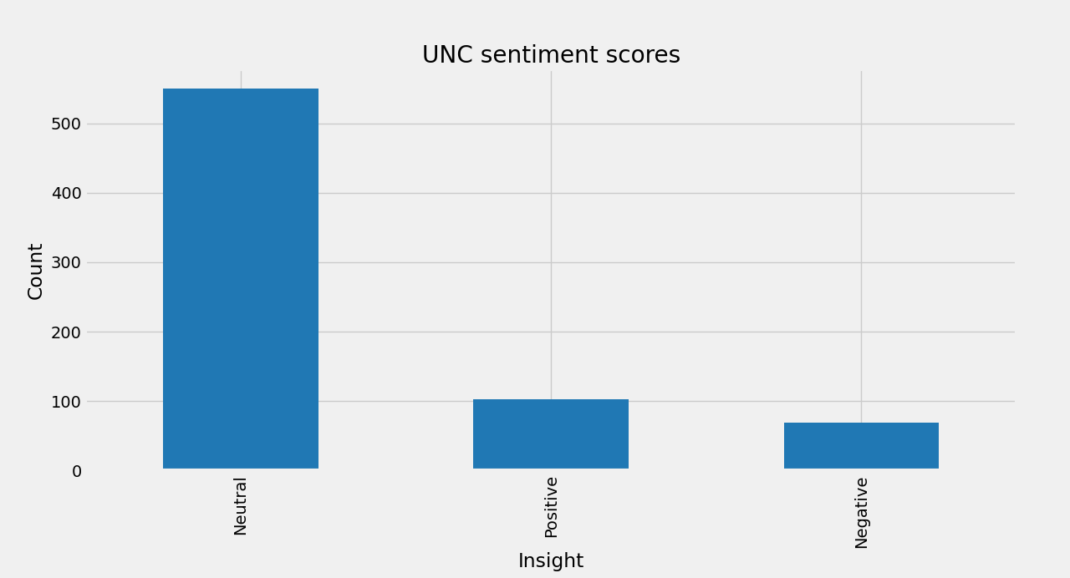
Bonus
Overall sentiment of 720 analyzed posts
r/UNC titles wordcloud

